Slide 1
Chapter 10: Serial Peripheral Interface (SPI)
The PIC18 Microcontroller
Han-Way Huang
Minnesota State University, Mankato
June 2004

Slide 2
The MSSP Module
Has two modes of operation:
1. Serial peripheral interface (SPI)
2. Inter-integrated circuit (I²C)
Can be used to interface with serial EEPROM, shift registers, display drivers, A/D converters, D/A converters, digital temperature sensors, time-of-day chips, etc.
Devices are divided into the master and slaves in a system that uses either the SPI or I²C protocol to exchange data.
The SPI and I²C module share the same signal pins and cannot to be active at the same time.
Three pins are used by this module:
1. Serial data out (SDO)—RC5/SDO
2. Serial data in (SDI)—RC4/SDI/SDA
3. Serial clock (SCK)—RC3/SCK/LVDIN
A fourth signal pin, SS, may be used in slave mode

Slide 3
The SPI Mode
Eight bits of data are exchanged synchronously in one operation.
In slave mode, all four signals are used.
In master mode, the SS pin is not needed.
Registers for SPI mode operation:
1. MSSP control register 1 (SSPCON1)
2. MSSP status register (SSPSTAT)
3. Serial receive/transmit buffer (SSPBUF)
4. MSSP shift register (SSPSR)—not directly accessible by the user
A write to SSPBUF will also write into the SSPSR register
The contents of these registers are shown in the following slides.

Slide 4
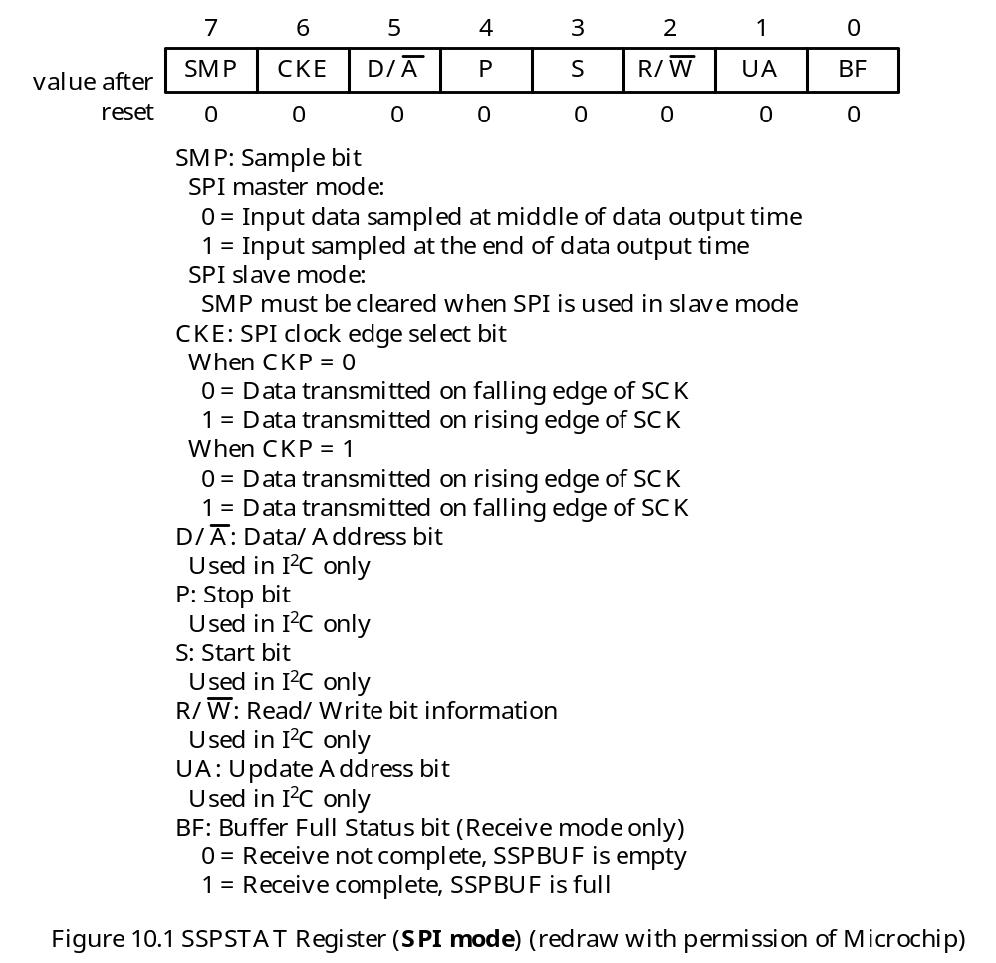

Slide 5
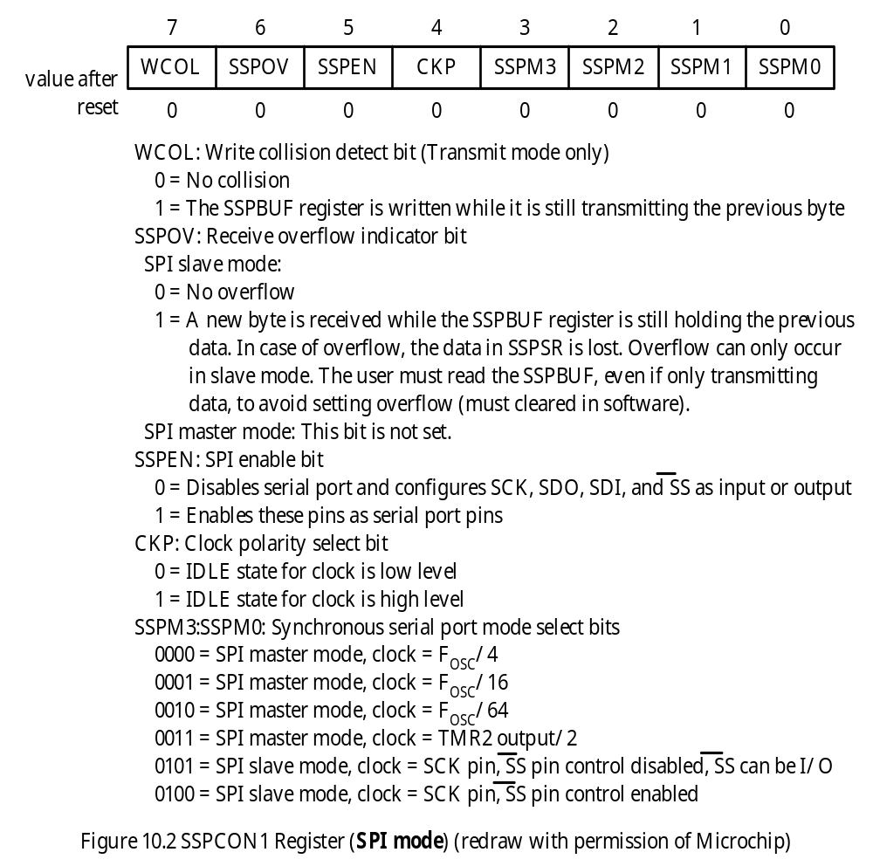

Slide 6
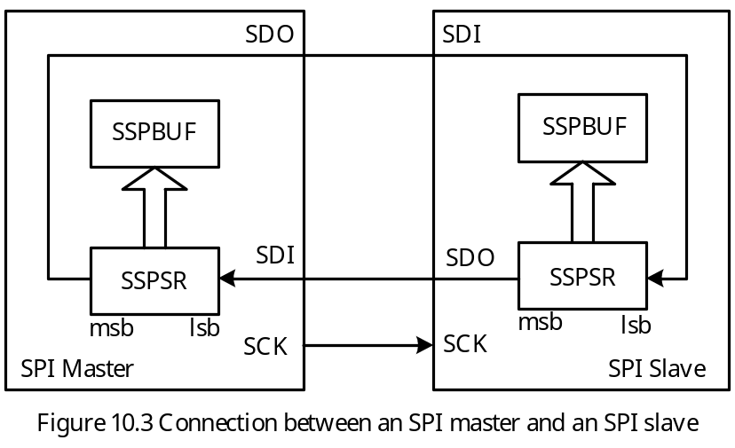
SPI Operation
- A simplified circuit connection between a SPI master and a slave is shown in Figure 10.3.
The SDO pin of the master is connected to the SDI pin of the slave.
The SDI pin of the master is connected to the SDO pin of the slave.
To send data to the slave, the master writes data to the SSPBUF register, after which, eight clock pulses are triggered and data is shifted to the slave.
To read data from the slave, the master writes into the SSPBUF register to trigger eight clock pulses to shift in data.

Slide 7
Data Shift Rate
In master mode, the SPI clock rate is programmable to one of the following:
1. F_{OSC}/4 (or T_{CY})
2. F_{OSC}/16 (or 4 × T_{CY})
3. F_{OSC}/64 (or 16 × T_{CY})
4. Timer2 output/2
Data rate is configured by the lowest four bits of the SSPCON1 register.
The highest data rate is 10 Mbps for 40 MHz crystal oscillator

Slide 8
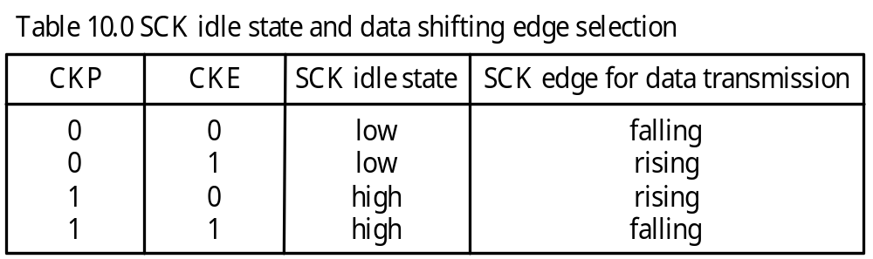
Clock Edge for Shifting Data
- When the SPI module is not transmitting data, it is referred to as idle.
- One can set the SCK signal to be idle low or idle high.
- Setting the CKP bit of the SSPCON1 register to 1, makes the SCK signal idle high.
The CKE bit of the SSPSTAT register and the CKP bit of the SSPCON1 register together select the edge of the SCK signal for shifting the data:
One can choose to use the middle or the end of a bit time to sample the incoming data.
When the SMP bit of the SSPSTAT register is 1, incoming data is sampled at the end of the bit time. Otherwise, incoming data is sampled at the middle of a bit time.

Slide 9
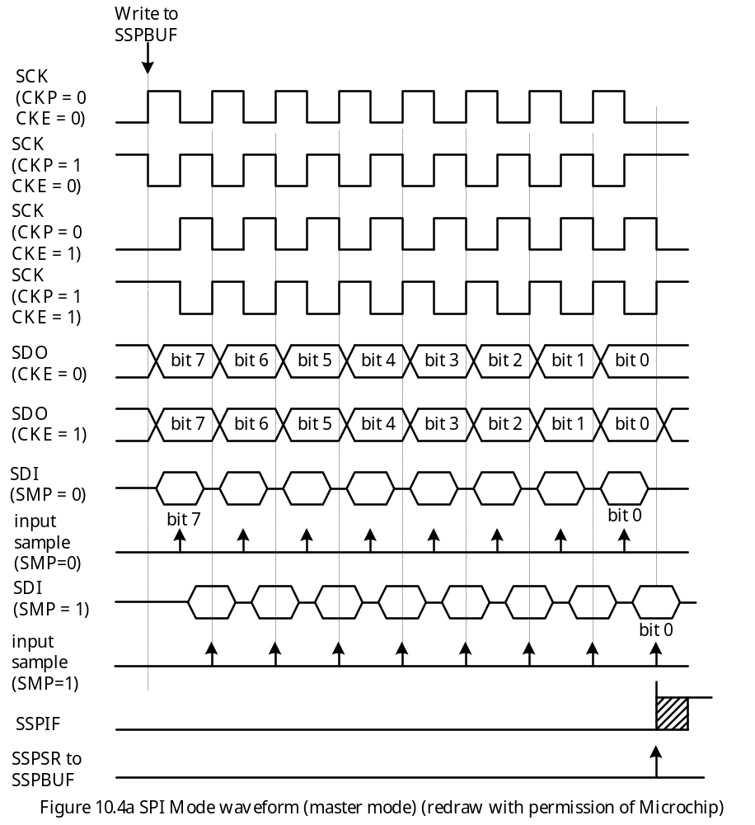

Slide 10
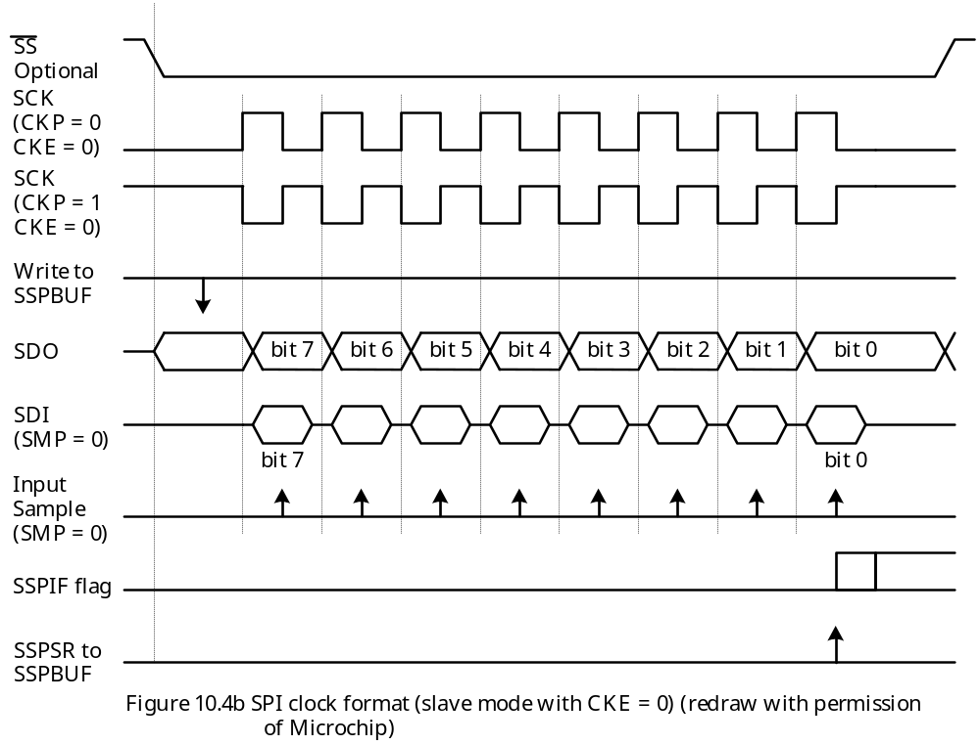

Slide 11
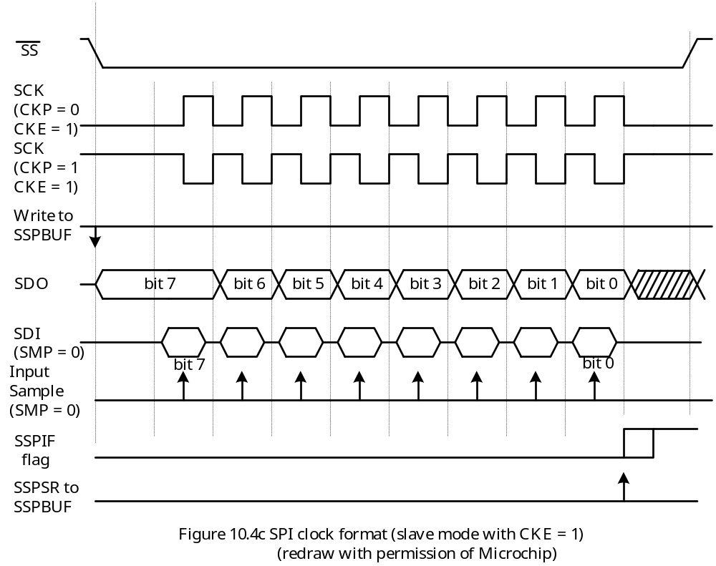

Slide 12
Example 10.1 Write an instruction sequence to configure the MSSP in the SPI master mode to shift data on the rising edge. The SCK signal must be idle low. The data rate should be set to at least 2 Mbps assuming that f_{OSC} is 32 MHz.
Solution: .
The CKP bit of the SSPCON1 register should be set to 0
The CKE bit of the SSPSTAT register should be set to 1.
Data rate can be set to either f_{OSC}/4 or f_{OSC}/16.
The following instruction sequence will achieve the desired setting:
movlw 0x21 ; enable SPI master mode, select idle
movwf SSPCON1,A ; low and set data rate to 2 Mbps
movlw 0x40 ; select rising edge to shift out data and
movwf SSPSTAT,A ; sample input data in the middle of a bit time
bsf TRISC,SDI ; configure SDI pin for input
bcf TRISC,SDO ; configure SDO pin for output
bcf TRISC,SCK ; configure SCK pin for output

Slide 13
SPI Data Transfer
The following instruction sequence sends out the contents of WREG through SPI:
movwf SSPBUF
loop1 btfss SSPSTAT,BF ; wait until the SPI transfer is complete
bra loop1 ; “
movf SSPBUF,W ; clear the BF flag
The following instruction sequence reads in a byte into WREG from the SPI:
movwf SSPBUF,A ; trigger 8 clock pulses on the SCK pin
loop2 btfss SSPSTAT,BF,A ; wait until SPI transfer is complete
bra loop2
movf SSPBUF,W ; copy data into WREG and clear BF bit

Slide 14
SPI Circuit Connection
The connection of one master to one slave is already shown in Figure 10.3.
There are many possibilities in connecting an SPI master to multiple SPI slaves.
Two connection methods are shown in Figure 10.5 and 10.6.
The method shown in Figure 10.5 requires the use of port pins to select one of the SPI slave to perform the data transfer.
The method shown in 10.6 concatenate all the slaves into a single ring. This method does not require the use of port pins to select SPI slave device.

Slide 15
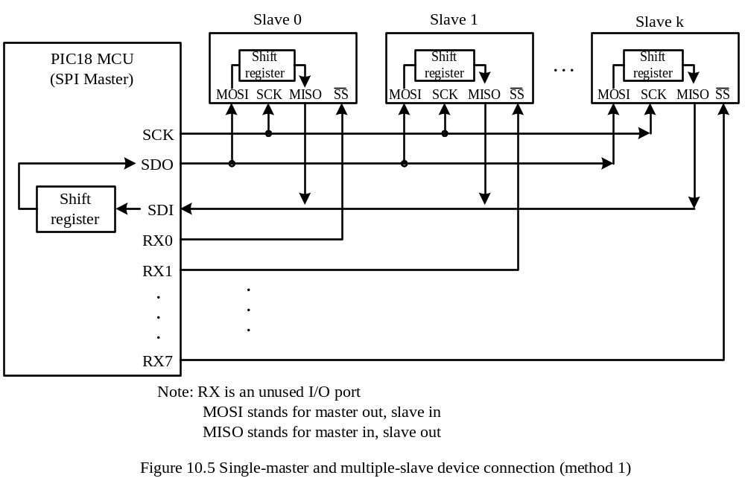

Slide 16
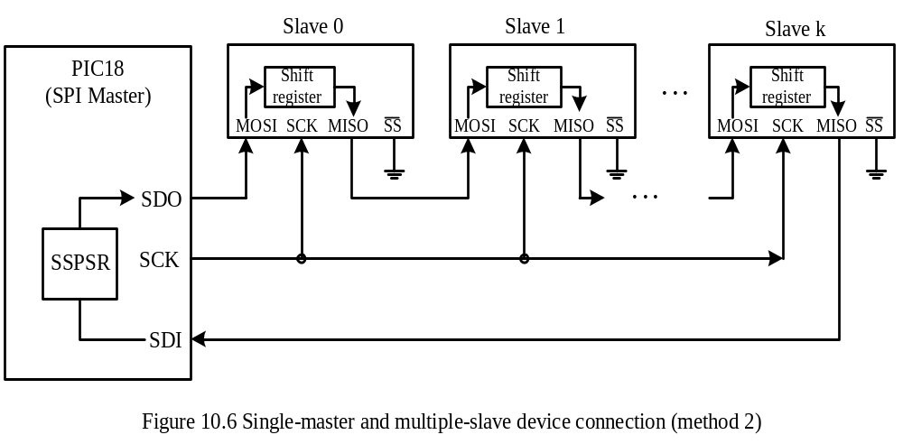

Slide 17
C Library Functions for SPI
1. void CloseSPI (void);
2. unsigned char DataRdySPI (void);
This function returns a 1 if there is new data in the SSPBUF register.
3. unsigned char getcSPI (void);
4. unsigned char ReadSPI (void);
5. void getsSPI (unsigned char *rdptr, unsigned char length);
This function reads length bytes from an SPI slave and saves them in a buffer pointed to by rdptr.
6. unsigned char putcSPI (unsigned char data_out);
7. unsigned char writeSPI (unsigned char data_out);
8. void putsSPI (unsigned char *wrptr);
This function writes a NULL-terminated string to the SPI port.
9. void OpenSPI (unsigned char sync_mode, unsigned char bus_mode, unsigned char smp_phase);
Values of arguments are listed in the following slides.

Slide 18
Values of the argument sync_mode:
SPI_FOSC_4 SPI master mode, clock = F_{OSC}/4
SPI_FOSC_16 SPI master mode, clock = F_{OSC}/16
SPI_FOSC_64 SPI master mode, clock = F_{OSC}/64
SPI_FOSC_TMR2 SPI master mode, clock = TMR2 output/2
SLV_SSON SPI slave mode, /SS pin control enabled
SLV_SSOFF SPI slave mode, /SS pin control disabled
Values of the argument bus_mode:
MODE_00 idle low, shift on rising edge
MODE_01 idle low, shift on falling edge
MODE_10 idle high, shift on falling edge
MODE_11 idle high, shift on rising edge
Values of the argument smp_phase
SMPEND Input data sample at end of data out
SMPMID Input data sample at middle of data out

Slide 19
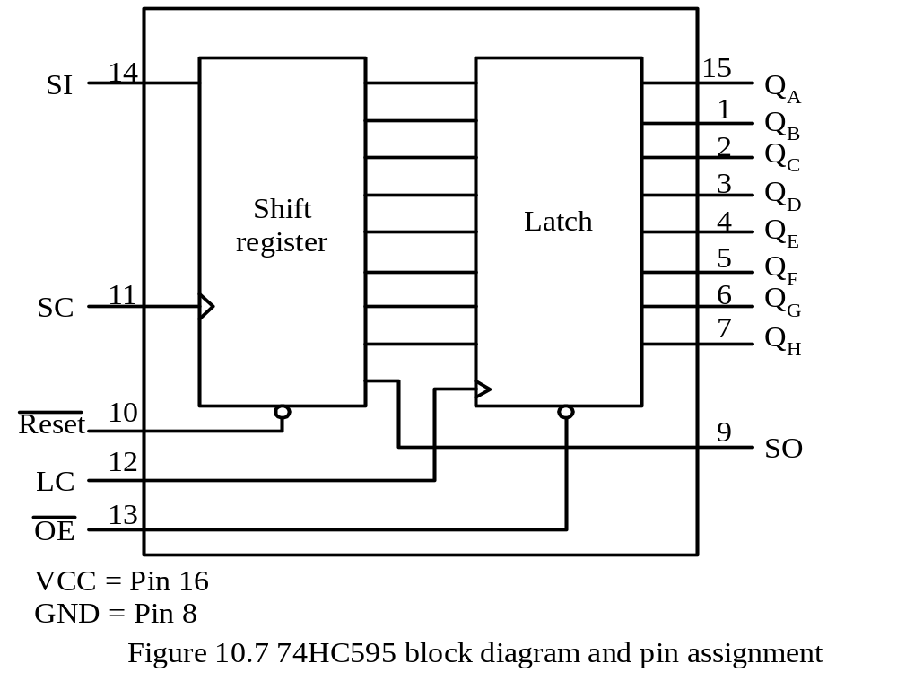
Interfacing with the 74HC595
The 74HC595 consists of an 8-bit shift register and an 8-bit D-type latch with tri- state parallel output.
The block diagram and pin assignment of the 74HC595 are shown in Figure 10.7.

Slide 20
Operation of the 74HC595
The SI and SO pins are the serial input and serial output, respectively.
The data is shifted in on the rising edge of the SC signal.
The value of the shift register will be loaded into the output latch on the rising edge of the LC signal.
The 74HC595 can be used to add parallel output ports to the PIC18.
Example 10.2 Describe how to use two 74HC595 to drive up to eight common-cathode seven-segment displays assuming that the crystal oscillator frequency is 32 MHz.
Solution:
Use two 74HC595 to drive eight seven-segment displays using time-multiplexing technique.
The circuit is shown in Figure 10.8.
One 74HC595 holds the segment pattern value whereas the other 74HC595 carries the digit select signals.

Slide 21
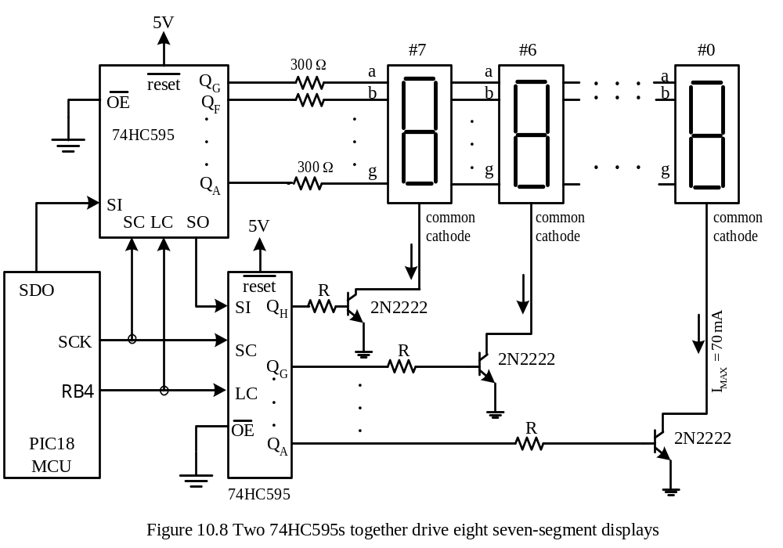

Slide 22
The Q_{H} output is not needed to carry segment pattern.
A table is used to hold the segment patterns and the corresponding digit select values.
To use time-multiplexing technique, Timer2 is configured to generate periodic interrupt every 1 ms. A pair of new pattern and digit select values are sent to these 74HC595s.
There are four parts in the program:
Part 1. Display table initialization
1. Load display data table address into TBLPTR registers.
2. Initialize table entry count to 8.
Part 2. Timer2 setup
1. Configure Timer2 with prescaler set to 4 and postscaler set to 16
2. Set the period of Timer2 counting to 124 by loading 124 into the PR register. This will generate an interrupt once every 1 ms.

Slide 23
Part 3. MSSP configuration
Configure MSSP in SPI mode to shift data at 8 MHz on the rising clock edge.
Send out the first digit on the display table to be displayed.
Part 4. Timer2 interrupt service routine
1. Decrement table entry count by 1. If the result is 0, then reload the table pointer to the start of the display table and reset the table entry count to 8.
2. Send digit pattern and digit select bytes to 74HC595s.
3. Transfer the values to the output latches of 74HC595s.
The complete program is in the following slides.

Slide 24
#include <p18F452.inc>
lp_cnt set 0x00 ; display loop count
org 0x00
goto start
org 0x08
goto hi_ISR
org 0x18
retfie
start movlw upper disp_tab ; set up pointer to display
movwf TBLPTRU,A ; pattern table
movlw high disp_tab ; "
movwf TBLPTRH,A ; "
movlw low disp_tab ; "
movwf TBLPTRL,A ; "
movlw 8 ; set loop count to 8
movwf lp_cnt,A ; for hi_ISR
; configure Timer2 to generate periodic interrupt every 1 ms
movlw 0x7D ; timer2 prescaler set to 4, postscaler
movwf T2CON,A ; set to 16, turn on Timer2
movlw D'124' ; Timer2 period set to 125
movwf PR2,A ; "

Slide 25
; configure SPI mode
movlw 0xC0
movwf SSPSTAT,A ; data transmitted on rising edge
movlw 0x21 ; select SPI master mode and shift
movwf SSPCON1,A ; data at FOSC/16, enable SPI
bsf TRISC,SDI,A ; configure SDI pin for input
bcf TRISC,SDO,A ; configure SDO pin for output
bcf TRISC,SCK,A ; configure SCK pin for output
bcf TRISB,RB4,A ; configure RB4 pin for output
tblrd*+ ; read the digit select byte
movff TABLAT,SSPBUF ; send to 74HC595
wait1 btfss SSPSTAT,BF,A ; is SPI transfer completed?
bra wait1
movf SSPBUF,W,A ; clear the flag
tblrd*+ ; read the digit pattern value
movff TABLAT,SSPBUF ; send to 74HC595
wait2 btfss SSPSTAT,BF,A ;
bra wait2
movf SSPBUF,W,A ; clear the flag

Slide 26
bcf PORTB,RB4,A ; transfer data to output latch
bsf PORTB,RB4,A ; "
; configure interrupt
bsf RCON,IPEN,A ; enable priority interrupt
bcf PIR1,TMR2IF,A ; clear Timer2 interrupt flag
movlw 0xC0
movwf INTCON,A ; enable global interrupt
clrf TMR2,A ; clear Timer2
bsf PIE1,TMR2IE,A ; enable Timer2 overflow interrupt
forever nop
goto forever ; wait forever

Slide 27
; ***********************************************************************
; The hi_ISR makes sure that the interrupt is caused by TMR2IF.
; If lp_cnt is decremented to zero, the ISR reloads lp_cnt and
; table pointer. Otherwise it sends the next digit to update displays.
; ***********************************************************************
hi_ISR btfss PIR1,TMR2IF,A ; is interrupt caused by TMR2 overflow?
retfie ; return if interrupt not caused by TMR2IF
decf lp_cnt,F,A
bz reload
send_dat tblrd*+ ; read the digit select byte
movff TABLAT,SSPBUF ; send to 74HC595
wait3 btfss SSPSTAT,BF,A ; is SPI transfer completed?
bra wait3
movf SSPBUF,W,A ; clear the flag
tblrd*+ ; read the digit pattern value
movff TABLAT,SSPBUF ; send to 74HC595
wait4 btfss SSPSTAT,BF,A ;
bra wait4
movf SSPBUF,W,A ; clear the flag

Slide 28
bcf PORTB,RB4,A ; transfer data to output latch
bsf PORTB,RB4,A ; "
retfie
reload movlw upper disp_tab ; set up pointer to display
movwf TBLPTRU,A ; pattern table
movlw high disp_tab ; "
movwf TBLPTRH,A ; "
movlw low disp_tab ; "
movwf TBLPTRL,A ; "
movlw 8 ; set loop count to
movwf lp_cnt,A ; 8
goto send_dat
disp_tab db 0x80,0x7F,0x40,0x70,0x20,0x5F,0x10,0x5B
db 0x08,0x33,0x04,0x79,0x02,0x6D,0x01,0x30
end
The C language version of the program is in the following slides.

Slide 29
include <p18F452.h>
int icnt;
unsigned char disp_tab [8][2] = {{0x80,0x7F},{0x40,0x70},{0x20,0x5F},
{0x10,0x5B},{0x08,0x33},{0x04,0x79},
{0x02,0x6D},{0x01,0x30}};
void high_ISR(void);
void low_ISR(void);
unsigned char temp;
#pragma code high_vector = 0x08
void high_interrupt(void)
{
_asm
goto high_ISR
_endasm
}
#pragma code low_vector = 0x18
void low_interrupt (void)
{
_asm
retfie 0
_endasm
}

Slide 30
#pragma code
#pragma interrupt high_ISR
void high_ISR(void)
{
if (!PIR1bits.TMR2IF) {
_asm
retfie 0
_endasm
}
PIR1bits.TMR2IF = 0; /* clear TMR2IF flag */
icnt ++;
if (icnt == 8)
icnt = 0;
SSPBUF = disp_tab[icnt][0]; /* send out digit select byte */
while(!SSPSTATbits.BF); /* wait until SPI transfer is complete */
temp = SSPBUF; /* clear the flag */
SSPBUF = disp_tab[icnt][1]; /* send out digit pattern */
while(!SSPSTATbits.BF);
temp = SSPBUF; /* clear the flag */
PORTBbits.RB4 = 0; /* create a rising edge on LC pin to */
PORTBbits.RB4 = 1; /* load data to output latch of 74HC595 */

Slide 31
_asm
retfie 0
_endasm
}
void main (void)
{
/* set up MSSP */
SSPSTAT = 0xC0; /* use rising edge to shift data */
SSPCON1 = 0x21; /* enable SPI to shift data at 2 Mbps */
TRISCbits.TRISC5 = 0; /* configure SDO pin for output */
TRISCbits.TRISC3 = 0; /* configure SCK pin for output */
TRISCbits.TRISC4 = 1; /* configure SDI pin for input */
TRISBbits.TRISB4 = 0; /* configure RB4 pin for output */
/* configure interrupt priority and enabling */
RCON |= 0x80; /* enable priority interrupt */
INTCON = 0xC0; /* enable global interrupt */
PIR1bits.TMR2IF = 0;
PIE1bits.TMR2IE = 1; /* enable Timer2 overflow interrupt */
PIR1bits.SSPIF = 0; /* clear the SSPIF flag */
SSPBUF = disp_tab[0][0]; /* send out digit select byte */

Slide 32
while(!SSPSTATbits.BF); /* wait until 8 bits have been shifted out */
temp = SSPBUF; /* clear the flag */
SSPBUF = disp_tab[0][1]; /* send out digit pattern */
while(!SSPSTATbits.BF);
temp = SSPBUF; /* clear the flag */
PORTBbits.RB4 = 0; /* create a rising edge on LC pin to */
PORTBbits.RB4 = 1; /* load data to output latch of 74HC595 */
/* configure Timer2 */
TMR2 = 0; /* Timer2 count from 0 */
T2CON = 0x7D; /* prescaler set to 4, postscaler set to 16 */
PR2 = 124; /* set Timer2 period to 125 */
icnt = 0; /* display table entry count set to 0 */
while (1) {};
}

Slide 33
MAX7221 Seven-Segment Display Driver
Can drive up to eight common-cathode seven-segment displays
Can also drive bar-graph displays, panel meters, and LED matrix displays.
Users can choose to use the code-B decode method to represent digits 0 through 9, and characters -, E, H, L, P, and space.
Users can also use no-decode method to define additional characters.

Slide 34
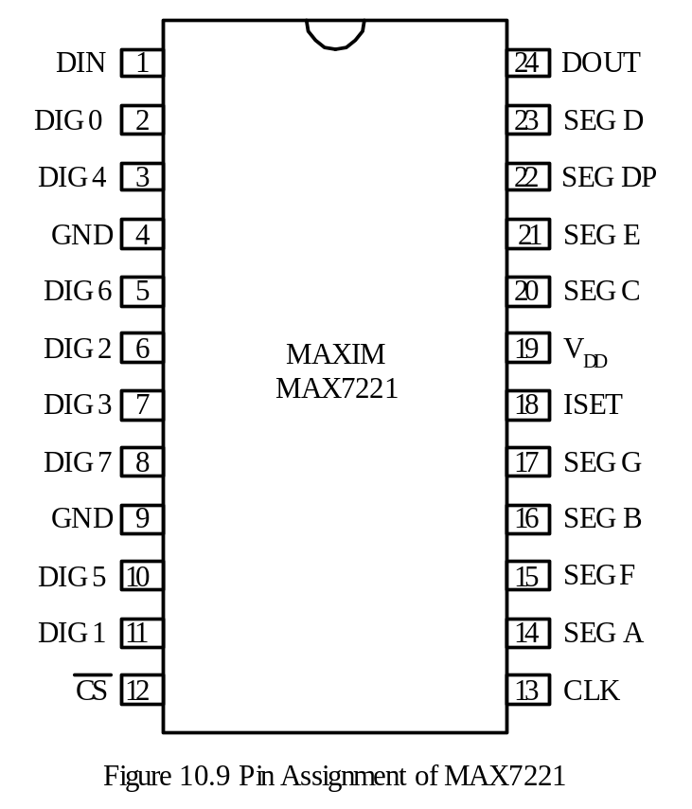
Signal Pins
The CS pin (setting low) enables the MAX7221 to exchange data with a microcontroller.
The CLK pin is the clock input.
SEG A through SEG G, DP are seven-segment drives and decimal point.
The ISET input allows the user to connect a current setting resistor.
The DIN pin is the serial data input.
DIG0 through DIG7 are the digit select lines.
The DOUT is the serial data out that allows multiple MAX7221 to be cascaded.

Slide 35
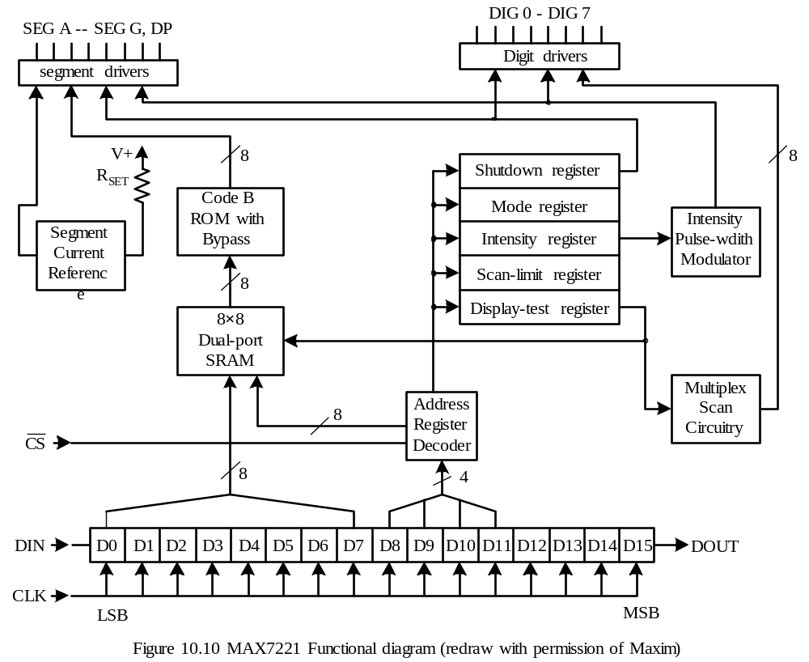

Slide 36
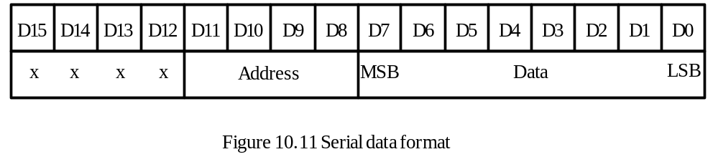
Serial Shift Register
When CS signal is low, one can sends in command to configure the MAX7221 and send in the value to be displayed in each digit.
The format of this register is shown in Figure 10.11.
The most significant 4 bits are not used.
The bit 11 through bit 8 (D11 through D8 in Figure 10.11) specify the address of the register to receive data.
The lowest 8 bits (D7 through D0 in Figure 10.11) carry the value to be sent to the destination register.
The addresses of all digits and control registers are listed in Table 10.6.
For example, one needs to send “0000100000001000” to display 8 on digit 7.

Slide 37
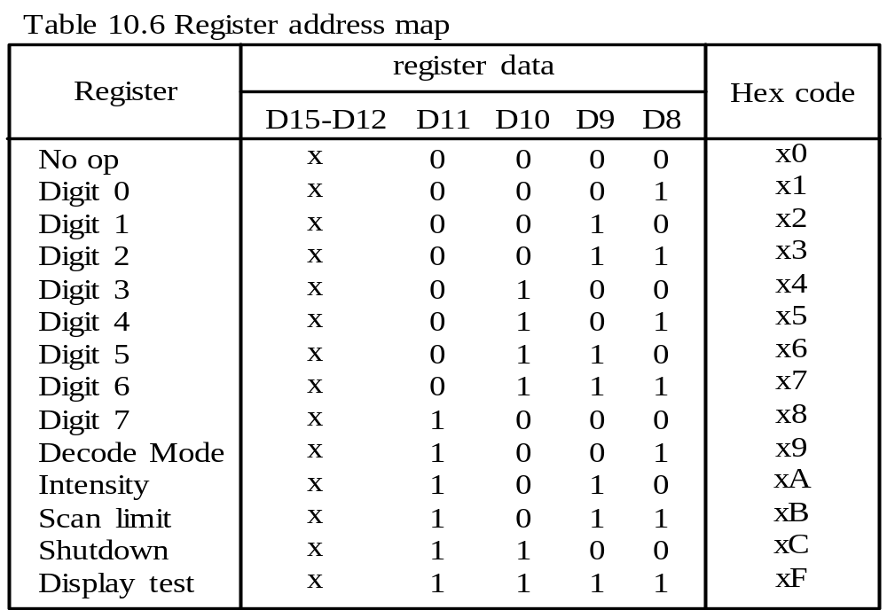

Slide 38
Code B ROM
Holds the segment patterns for ten decimal digits and a few letters.
The code-B patterns are shown in Table 10.2.
In normal operation, the digit registers (in dual-port SRAM) participating the display send out the addresses to the ROM location to select the segment patterns to be displayed.
When the bit 7 of the ROM address is 1, the decimal point will be displayed.
In no-decode mode, the segment pattern for a digit is stored directly in the two-port SRAM.

Slide 39
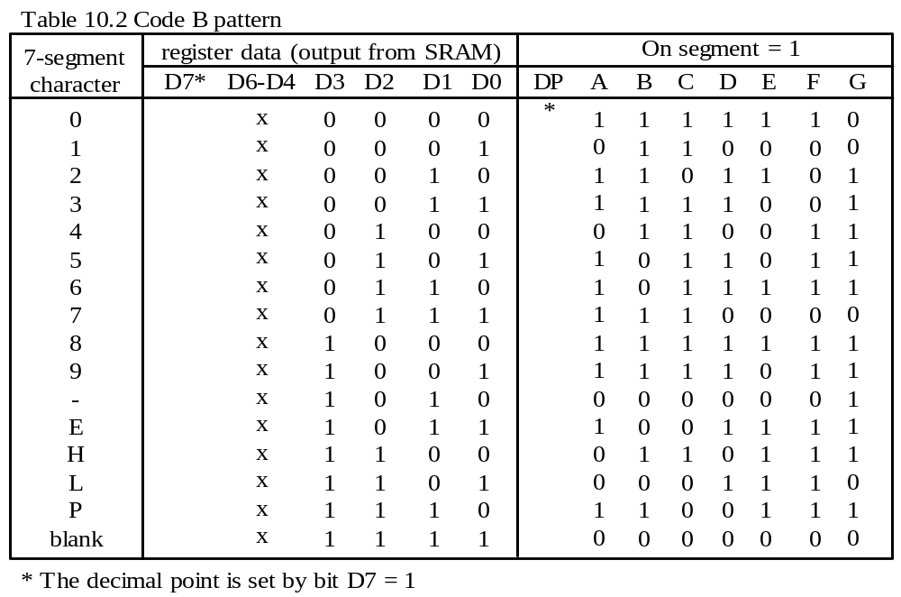

Slide 40
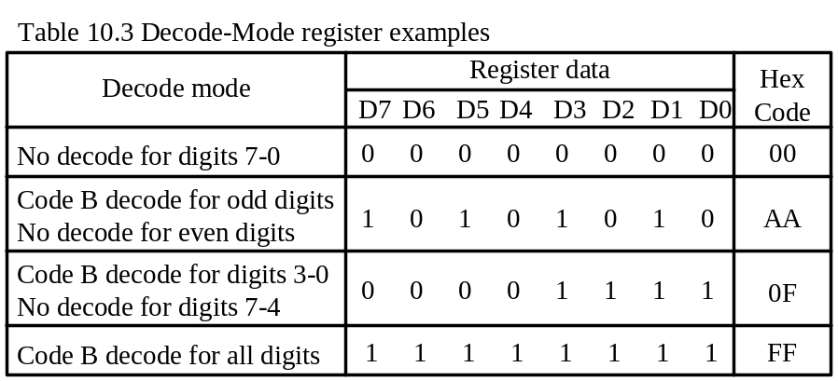
Digit Drivers and Multiplex Scan Circuitry
The MAX7221 uses time-multiplexing technique to display multiple digits.
Mode Register
This register sets code-B decode or no-decode for each digit.
Each bit of this register corresponds to a digit.
A logic high selects code-B method for a digit. A logic low selects no-decode.
A few examples are shown in Table 10.3.

Slide 41
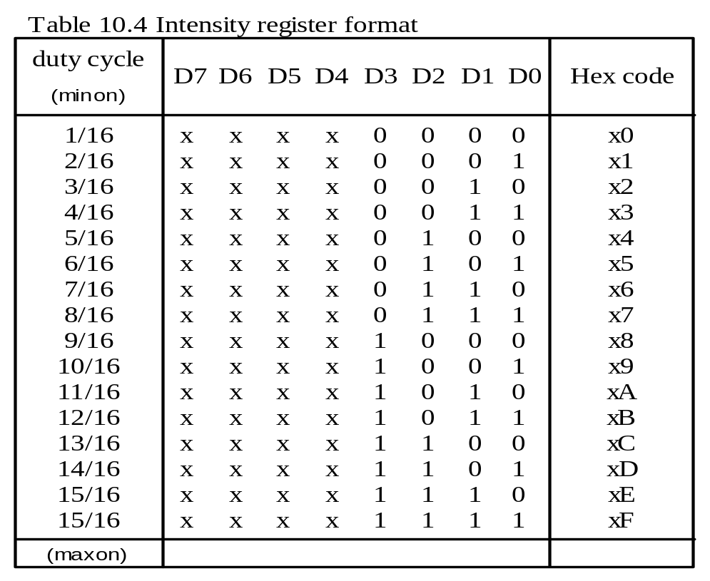
Intensity Control and Inter-Digit Blanking
The resistor connected to the ISET pin determines the maximum brightness of each segment by setting the maximum current that flows through the segment.
The lower four bits of this register further regulate the actual intensity of all segments.

Slide 42
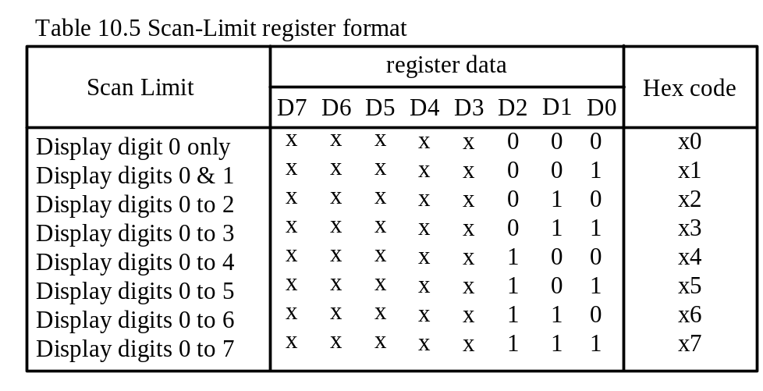
Scan Limit Register
This register sets the number of digits to be displayed.
The digits to be displayed are contiguous starting from digit 0 up to digit 7.
Shutdown Mode Register
To shutdown segment drivers, clear the bit 0 of this register to 0.
In normal mode, the bit 0 of this register should be 1.
Display Test Register
Setting the bit 0 of this register to 1 will turn on all segments in maximum intensity.
In normal mode, the bit 0 of this register should be cleared to 0.

Slide 43
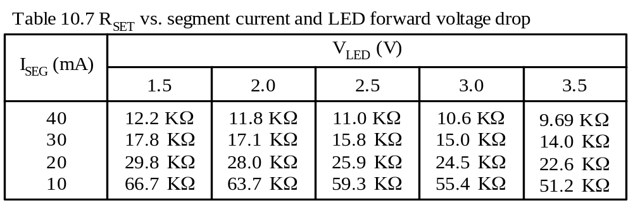
Choosing the Value for R_{SET}
A sample resistor values for setting the maximum segment current at certain voltage drop across the LED are shown in Table 10.7.
For LED voltages not shown in the table, the resistor values can be computed by using interpolation method.
The resistor for setting segment current to 10 mA with 2.3V forward LED voltage drop is calculated as follows:
(2.3 – 2.0)/(2.5 – 2.0) = (63.7 – R_{SET})/(63.7 – 59.3) => RSET = 62 KΩ.

Slide 44
Example 10.3 Use a MAX7221 and six seven-segment displays to display the value
-42.5ºC. Show the circuit connection and write a program to display the given value. Assume enough brightness can be obtained when there is 10 mA current flowing through the LED and the VLED at this current is 2.3V. Assume that the PIC18F8720 is running with a 16 MHz crystal.
Solution:
The circuit is shown in Figure 10.12.
Both the degree character and the letter C must be displayed using non-decode method. Other digits can be displayed using the code-B decode method.

Slide 45
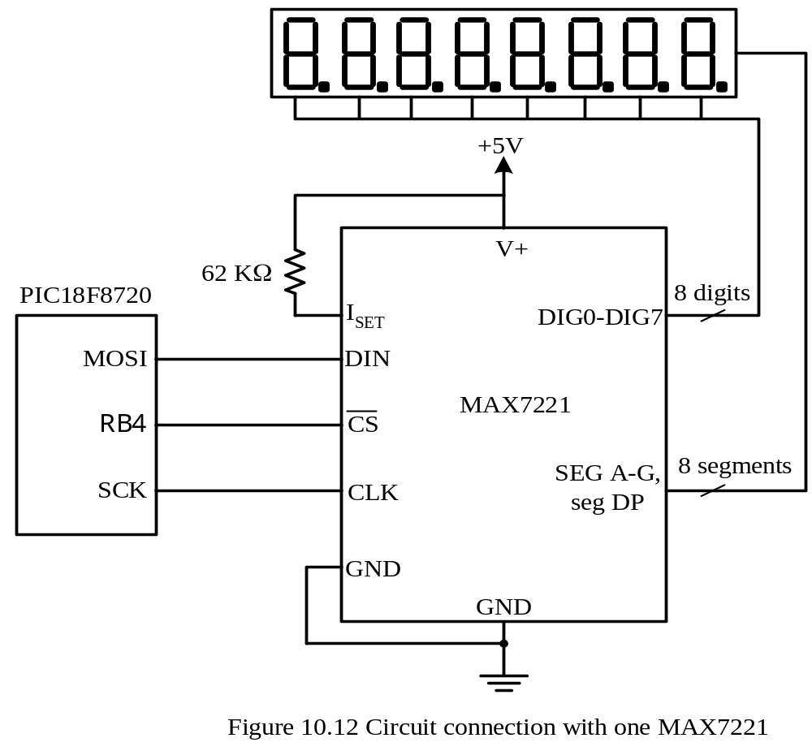

Slide 46
To display -42.5ºC, one needs to figure out the values to be written into appropriate registers.
Scan Limit Register
The temperature is to be displayed on digits 5 through 0 with digit 5 displayed minus sign and digit 0 displayed letter C.
The 16-bit value to achieved this is 0x0B05.
Decode Mode Register
The degree character and letter cannot be decoded and must be displayed in non- decode mode.
All other characters (-42.5) can be displayed in code-B decode method.
The 16-bit value to achieve this is 0x09FC.
Intensity Register
The maximum intensity should be used to display all the digits.
The value to achieve this is 0x0A0F.
Shutdown Register
The digits should be turned on normally.
The value to achieve this is 0x0C01.

Slide 47
Display Test Register
- All digits must be used normally not to be tested.
The value to achieve this is 0x0F00.
Digit 0 (to display the letter C)
No-decode mode is used in this digit.
Segments a, d, e, and f should be turned on whereas other segments should be turned off.
The 16-bit value to achieve this is 0x014E.
Digit 1 (to display º)
No-decode mode is used in this digit.
Segments a, b, f, and g should be turned on whereas other segments should be turned off.
The 16-bit value to achieve this is 0x0263.
Digit 2 (to display 5)
Code-B decode method is used for this digit.
Decimal point should not be turned on.
The 16-bit value to achieve this is 0x0305.

Slide 48
Digit 3 (to display 2)
Code-B decode method is used.
A decimal-point should be turned on.
The 16-bit value to achieve this is 0x0482.
Digit 4 (to display 4)
Code-B decode method is used.
Decimal-point is not turned on.
The 16-bit value to achieve this is 0x0504.
Digit 5 (to display -)
Code-B decode method is used
The 16-bit value to achieve this is 0x060A.
The program to send these values to the MAX7221 is in the following slides.

Slide 49
#include <p18F8720.inc>
lp_cnt equ 11
org 0x00
goto start
org 0x08
retfie
org 0x18
retfie
start call spi_init
call send2max
forever nop
goto forever
spi_init movlw 0xC0 ; input data sampled at the end of a bit time,
movwf SSPSTAT,A ; data is shifted on the rising edge of SCK
movlw 0x20 ; set SPI master mode, set the
movwf SSPCON1,A ; SPI clock to f_{OSC}/4 = 4 MHz
bcf TRISC,SDO,A ; configure SDO pin for output
bcf TRISC,SCK,A ; configure SCK pin for output
bcf TRISB,RB4,A ; configure RB4 pin for output
return

Slide 50
; **************************************************************************
; The following subroutine sends data to MAX7221 for displaying 42.5ºC.
; **************************************************************************
send2max movlw upper disp_dat ; set TBLPTR to point to the start of disp_dat
movwf TBLPTRU,A ; “
movlw high disp_dat ; “
movwf TBLPTRH,A ; “
movlw low disp_dat ; “
movwf TBLPTRL,A ; “
movlw lp_cnt
movwf PRODL,A ; use PRODL as the loop count
send_lp bcf PORTB,RB4,A ; enable data to be shifted into MAX7221
tblrd*+ ; read the upper 16 bits
movf SSPBUF,W,A ; clear the BF flag
movff TABLAT,SSPBUF ; send to MAX7221
wait1 btfss SSPSTAT,BF,A ; wait until 8 bits are shifted into MAX7221
bra wait1
movf SSPBUF,W,A ; clear the BF flag
tblrd*+ ; read the lower 8 bits
movff TABLAT,SSPBUF ; send to MAX7221
wait2 btfss SSPSTAT,BF,A ; wait until 8 bits are shifted into MAX7221

Slide 51
goto wait2
bsf PORTB,RB4,A ; latch the lower 8 bits of data
decfsz PRODL,F,A ; decrement the loop count
goto send_lp ; not done yet and continue
return
disp_dat db 0x0B,0x05 ; data for scan limit register
db 0x09,0xFC ; data for decode mode register
db 0x0A,0x0F ; data for intensity register
db 0x0C,0x01 ; value for shutdown register
db 0x0F,0x00 ; value for display test register
db 0x01,0x4E ; value for digit 0 register (letter C)
db 0x02,0x63 ; value for digit 1 register (degree character)
db 0x03,0x05 ; value for digit 2 register (value 5)
db 0x04,0x82 ; value for digit 3 register (value 2 with DP)
db 0x05,0x04 ; value for digit 4 register (value 4)
db 0x06,0x0A ; value for digit 5 register (minus sign)
end

Slide 52
Cascading MAX7221s
Wire the CS pins of all MAX7221s together and connect them to one of the output pin of the PIC18.
Wire the CLK pins of all MAX7221s together and connect them to the SCK pin of the PIC18.
Wire the DIN pin of the first MAX7221 to the SDO pin of the PIC18.
Wire the DOUT pin of each MAX7221 to the DIN pin of the next MAX7221, and so on.
The circuit of two cascaded MAX7221 is shown in Figure 10.13.

Slide 53
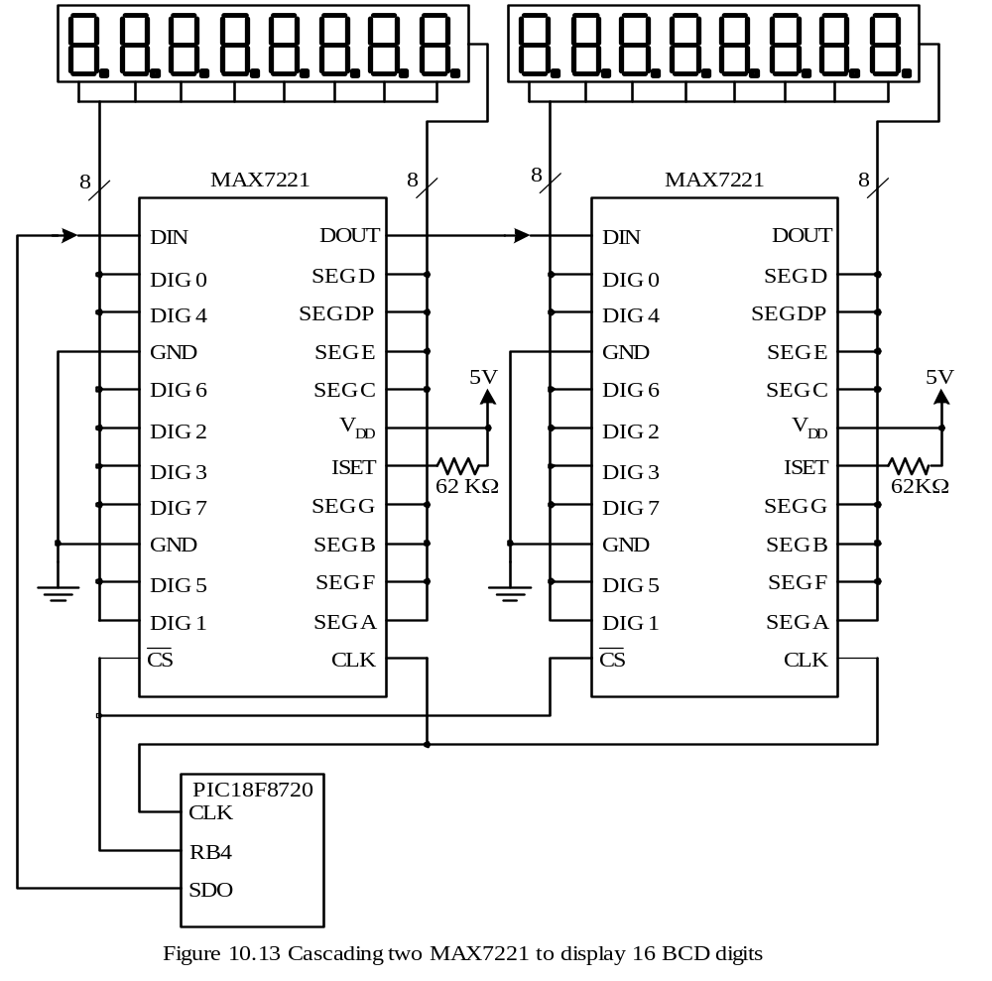

Slide 54
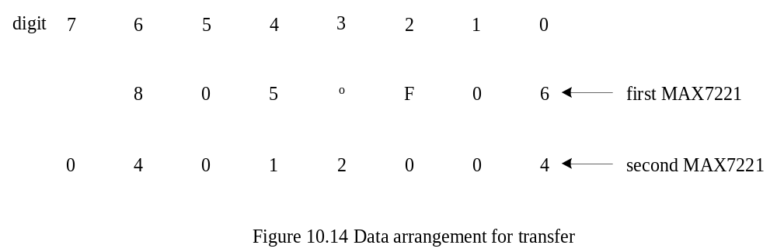
Example 10.4 Write a program to configure the MSSP module and display the value
80.5ºF 06 04 01 20 03
on the 16 seven-segment displays shown in Figure 10.13. Assume that the PIC18F8720 is driven by a 16-MHz crystal oscillator.
Solution:
Divide the given digital string into two parts as follows:
8 0.5 ºF 06
04 01 20 03
The first MAX7221 displays seven characters, whereas the second MAX7221 displays eight digits. These characters are paired as shown in Figure 10.14.

Slide 55
The user needs to send 13 32-bit values to set display data:
Scan-limit register
The first and second MAX7221 will display seven and eight digits, respectively.
The user needs to send 0x0B06 and 0x0B07 to the scan-limit registers of the 1st and 2nd MAX7221.
Decode Mode Register
For the first MAX7221, no-decode method is used for digits 2 and 3 and code-B decode method is used for other digits.
For the second MAX7221, code-B decode method is used for all digits.
Send the value 0x09F3 and 0x09FF to the 1st and 2nd MAX7221
Intensity Register
Use maximum intensity to display all values.
Send the value 0x0A0F to both MAX7221s.
Shutdown Register
Send the value 0x0C01 to both MAX7221s for normal operation.

Slide 56
Display Test Register
Send the value of 0x0F00 to both MAX7221s for normal operation.
Digit 7 Register
The first MAX7221 does not display any value with this digit.
The second MAX7221 displays 0 in this digit.
Send 0x0000 and 0x0800 to the first and the second MAX7221, respectively.
Digit 6 Register
The first and the second MAX7221 will display 8 and 4 on this digit.
Send the values 0x0708 and 0x0704 to the first and the second MAX7221.
Digit 5 Register
Both MAX7221s will display 0 on this digit.
Send the value 0x0600 to both MAX7221s.
Digit 4 Register
The 1st and 2nd MAX7221 will display 5 and 1 on this digit.
Send the values 0x0505 and 0x0501 to the first and the second MAX7221, respectively.

Slide 57
Digit 3 Register
The 1st and the 2nd MAX7221 will display º and 2 on this digit, respectively.
Send the value 0x0463 and 0x0402 to the 1st and the 2nd MAX7221, respectively.
Digit 2 Register
The 1st and the 2nd MAX7221 will display F and 0 on this digit, respectively.
Send the value 0x0347 and 0x0300 to the 1st and the 2nd MAX7221, respectively.
Digit 1 Register
- Both MAX7221s will display 0 on this digit.
Send the value 0x0200 to both MAX7221s.
Digit 0 Register
The 1st and the 2nd MAX7221 will display 6 and 4 on this digit, respectively.
Send the value 0x0106 and 0x0104 to the 1st and the 2nd MAX7221, respectively.
The SPI setting used in the previous example can be used in this Example.
The table of data to be sent to these two MAX7221s is created by the assembler directives in the next slide.

Slide 58
; ********************************************************************
; The data to be sent to two MAX7221s are paired together. The data for the second
; MAX7221 are listed in the front because they should be sent out first.
; ********************************************************************
max_data db $0B,$07,$0B,$06 ; data for scan limit registers
db $09,$FF,$09,$F3 ; data for decode mode registers
db $0A,$0F,$0A,$0F ; data for intensity registers
db $0C,$01,$0C,$01 ; data for shutdown registers
db $0F,$00,$0F,$00 ; data for display test registers
db $08,$00,$00,$00 ; data for digit 7 registers
db $07,$04,$07,$08 ; data for digit 6 registers
db $06,$00,$06,$00 ; data for digit 5 registers
db $05,$01,$05,$05 ; data for digit 4 registers
db $04,$02,$04,$63 ; data for digit 3 registers
db $03,$00,$03,$47 ; data for digit 2 registers
db $02,$00,$02,$00 ; data for digit 1 registers
db $01,$04,$01,$06 ; data for digit 0 registers

Slide 59
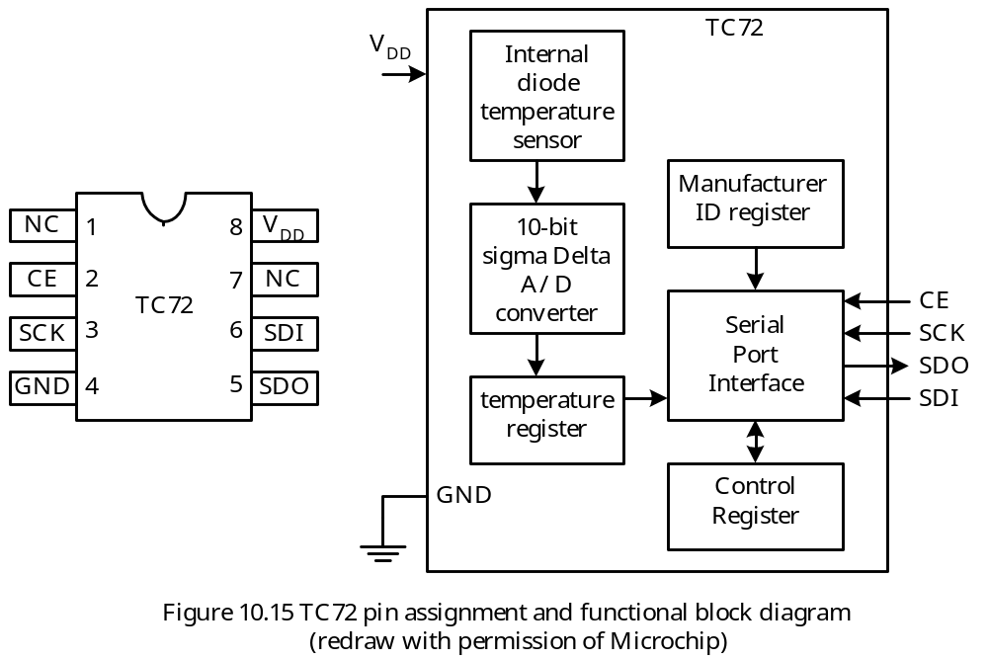
Digital Temperature Sensor TC72
Capable of reading temperatures from -55ºC to +125ºC.
Can be used in continuous conversion mode and one-shot conversion mode.
The continuous mode measures temperature approximately every 150 ms.
The one-shot mode measures the temperature once and enters into power-saving mode.

Slide 60
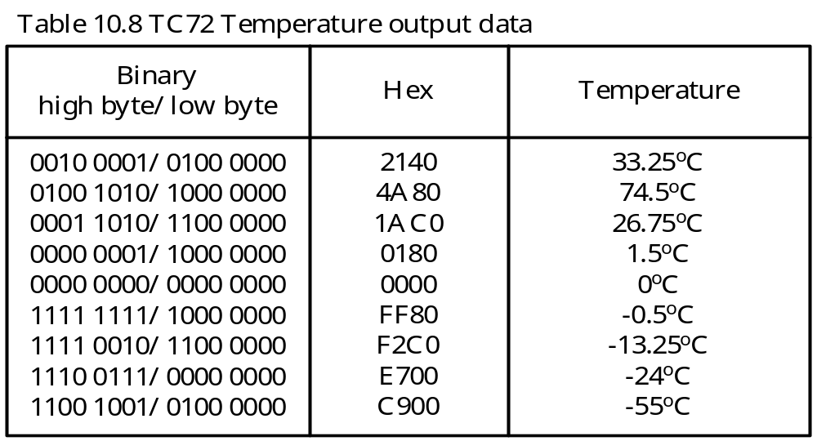
Temperature Data Format
TC72 uses 10 bits to represent temperature.
The on-chip A/D converter is scaled from -128ºC to +127ºC, but can only read temperature from -55ºC to +125ºC.
The 10-bit temperature is stored in two 8-bi registers.
The lowest two bits of the temperature are stored in the highest two bits of the lower byte of the temperature register.
Temperature is represented in 2’s complement format.
A negative temperature has its most significant bit set to 1.

Slide 61
The Serial Bus Interface of the TC72
The CE input enables the TC72 to exchange data with an MCU using SPI interface.
The SDI input writes data into the TC72’s control register.
The SDO output sends out the temperature data and the status of the shutdown bit of the control register.
TC72 can shift data using either the rising edge or the falling edge of the SCK signal.
Data transfer to and from the TC72 consists of one address byte followed by one or multiple data (2 to 4) bytes.
The bit 7 of the address byte determines whether a read (A7 = 0) or a write (A7 = 1) operation will occur.
Procedure for Reading Temperature Result
Step 1
Pull CE pin to high to enable SPI transfer.
Step 2
Send in temperature result high byte address (0x02) to the TC72.
Step 3
Read the temperature high byte
Step 4
Read the temperature low byte
Step 5
Pull the CE signal to low to disable SPI transfer.

Slide 62
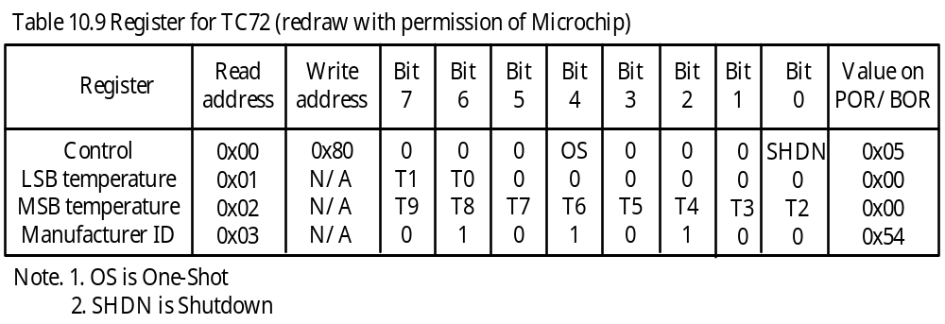
Internal Register Structure
TC72 has four internal registers: control register, temperature low byte, temperature high byte, and manufacturer’s ID.
The contents of these registers are shown in Table 10.9.
Control Register
This register is read and written at different addresses.
The OS bit allows the user to select one-shot mode.
The SHDN bit allows the user to shut down the TC72

Slide 63
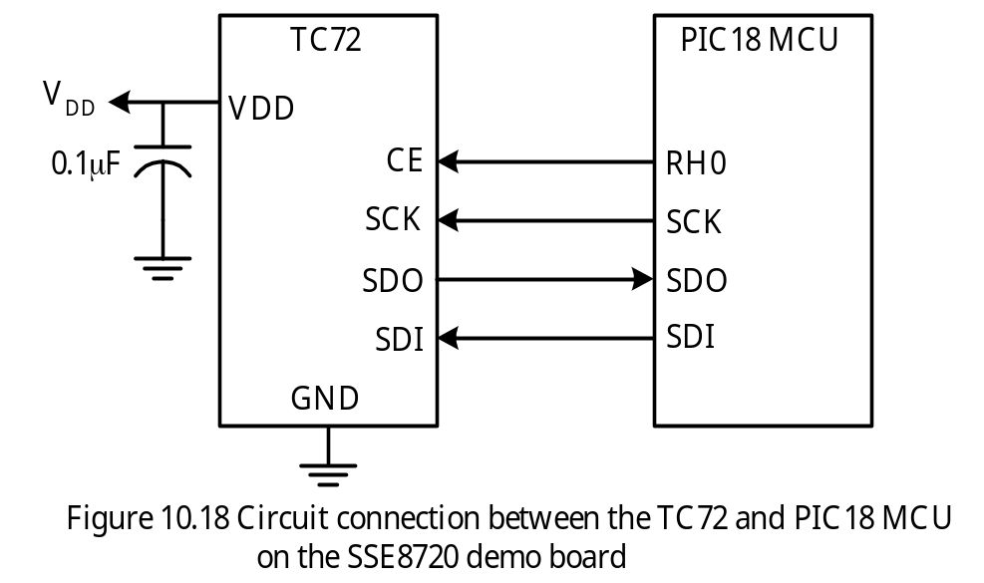
Example 10.5 Describe the circuit connection between the PIC18 MCU and TC72 for digital temperature reading and write a C program to read the temperature every 200 ms. Convert the temperature value into a string so that it can be displayed in an appropriate output device. A pointer to the buffer to hold the string will be passed to this function. The crystal oscillator of the demo board is assumed to be 16 MHz.
Solution: The circuit is shown in Figure 10.18.

Slide 64
#include <p18F8720.h>
#include <spi.h>
#include <stdlib.h>
#include <timers.h>
void wait_200ms(void);
void read_temp (char *ptr);
char buf[10];
void main (void)
{
TRISHbits.TRISH0 = 0; /* configure RH0 pin for output */
OpenSPI(SPI_FOSC_16, MODE_01, SMPEND);
read_temp(&buf[0]);
}
void read_temp (char *ptr)
{
char hi_byte, lo_byte, temp, *bptr;
unsigned int result;
bptr = ptr;
PORTHbits.RH0 = 1; /* enable TC72 data transfer */
SSPBUF = 0x80; /* send out TC72 control register write address */
while(!SSPSTATbits.BF); /* wait until data is shifted out */
temp = SSPBUF; /* clear the BF flag */

Slide 65
SSPBUF = 0x11; /* perform one shot conversion */
while(!SSPSTATbits.BF); /* wait until data is shifted out */
PORTHbits.RH0 = 0; /* disable TC2 data transfer */
temp = SSPBUF; /* clear the BF flag */
wait_200ms(); /* wait until temperature conversion is complete */
PORTHbits.RH0 = 1; /* enable TC72 data transfer */
SSPBUF = 0x02; /* send MSB temperature read address */
while(!SSPSTATbits.BF); /* wait until SPI transfer is complete */
temp = SSPBUF; /* clear BF flag */
SSPBUF = 0x00; /* read the temperature high byte */
while(!SSPSTATbits.BF); /* wait until SPI transfer is complete */
hi_byte = SSPBUF; /* save temperature high byte and clear BF */
SSPBUF = 0x00; /* read the temperature low byte */
while(!SSPSTATbits.BF); /* wait until SPI transfer is complete */
lo_byte = SSPBUF; /* save temperature low byte and clear BF */
PORTHbits.RH0 = 0; /* disable TC72 data transfer */
lo_byte &= 0xC0; /* make sure the lower 6 bits are 0s */
result = hi_byte * 256 + lo_byte;
if (hi_byte & 0x80) {
result = ~result + 1; /* take the two' complement of result */
result >>= 6;
temp = result & 0x0003; /* place the lowest two bits in temp */

Slide 66
result >>= 2; /* get rid of fractional part */
*ptr++ = 0x2D; /* store the minus sign */
itoa(result, ptr);
}
else {
result >>= 6;
temp = result & 0x0003; /* save fractional part */
result >>= 2; /* get rid of fractional part */
itoa(result, ptr); /* convert to ASCII string */
}
while(*bptr){ /* search the end of the string */
bptr++;
};
switch (temp){ /* add fractional digits to the temperature */
case 0:
break;
case 1: /* fractional part is .25 */
*bptr++ = 0x2E; /* add decimal point */
*bptr++ = 0x32;

Slide 67
*bptr++ = 0x35;
*bptr = '\0';
break;
case 2: /* fractional part is .5 */
*bptr++ = 0x2E; /* add decimal point */
*bptr++ = 0x35;
*bptr = '\0';
break;
case 3: /* fractional part is .75 */
*bptr++ = 0x2E; /* add decimal point */
*bptr++ = 0x37;
*bptr++ = 0x35;
*bptr = '\0';
break;
default:
break;
}
}

Slide 68
void wait_200ms(void)
{
OpenTimer0(TIMER_INT_OFF & T0_16BIT & T0_SOURCE_INT &
T0_PS_1_16);
TMR0 = 15535; /* let Timer0 overflow in 50000 clock cycles */
INTCONbits.TMR0IF = 0;
while(!INTCONbits.TMR0IF);
}

Slide 69
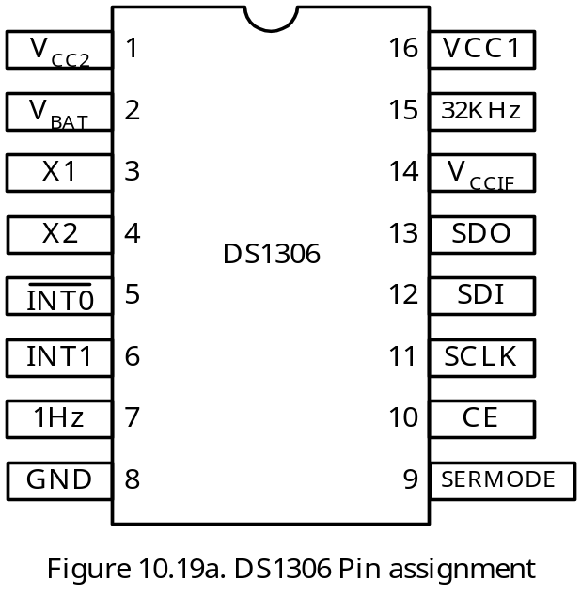
The DS1306 Alarm Real-Time Clock
Can keep track of seconds, minutes, hours, date of the month, month, day of the week, and year.
Supports SPI interface with two programmable alarms.
All time information are in BCD format for easy reading.
Both 12-hour and 24-hour formats are supported.
Signal Functions

Slide 70
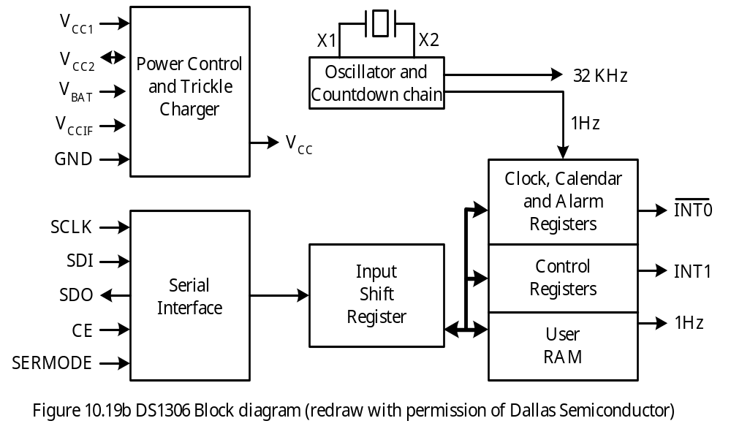

Slide 71
The V_{CC1} pin is the primary power supply
The V_{CC2} pin is to be connected to a rechargeable energy source.
The V_{BAT} pin is to be connected to a 3-V lithium cell.
The V_{CCIF} pin allows the DS1306 to drive the SDO and the 32KHz output pins to a level that is compatible with the interface logic, which might be 3V only.
The SERMODE allows the DS1306 to use either SPI protocol (when connected to V_{CC}) or 3-wire protocol (when grounded).
The INT0 pin can be programmed to be asserted by alarm 0.
The 1Hz pin provides 1 Hz output.
The INT1 pin can be programmed to be asserted by alarm 1.
The 32KHz pin provides 32KHz digital output.
The X1 and X2 pin are to be connected to a 32768-Hz quartz crystal
RTC Registers
The time counting and alarm generation are controlled by a large number of registers.
Some registers are read only whereas others are write only.
The time, calendar, and alarm are set by writing to appropriate registers.
Some bits are always 0.
The address map for the RTC is shown in Figure 10.20.

Slide 72
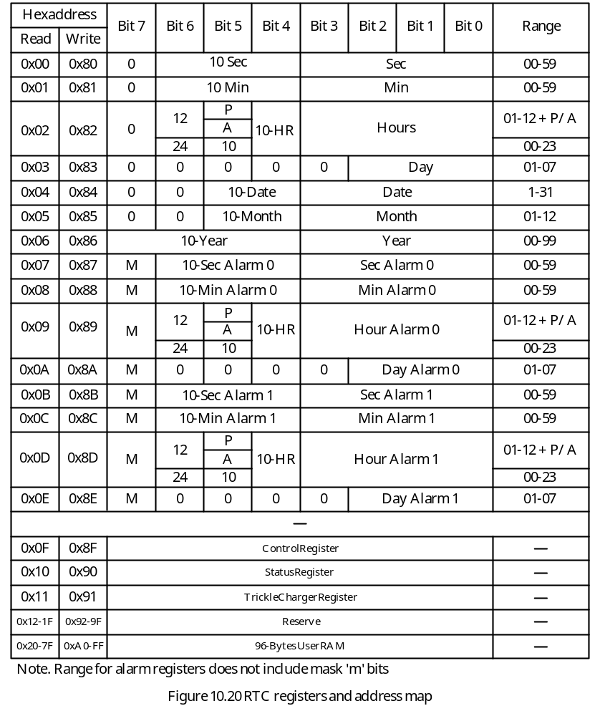

Slide 73
Burst Mode Access
The RTC maintains an internal pointer. This pointer is incremented after an access to the time register.
The user needs only send in the starting address to read a block of registers or write into a block of registers.
12-Hour or 24-Hour Mode
When bit 6 of the hours register is 1, the 12-hour mode is used. Otherwise, 24-hour mode is used.
In 12-hour mode, bit 5 of the hours register indicates AM (0) or PM (1).
In 24-hour mode, bit 5 and bit 4 are used as the 10-hour bits.
Alarms
There are two alarms: alarm 0 and alarm 1.
The alarm 0 is set by writing into registers 0x87 through 0x8A.
The alarm 1 is set by writing into registers 0x8B through 0x8E.
Bit 7 of the alarm register is a mask bit.
When bit 7 of the day alarm register is 1, alarm is generated every day.
When bit 7 of the day and hour alarm register are 1s, alarm is generated every hour.
When bit 7 of the day, hour, and minute registers are 1s, alarm is generated every minute.
RTC compares the alarm 0 and alarm 1 against the current time and sets the alarm status flag if they match.

Slide 74
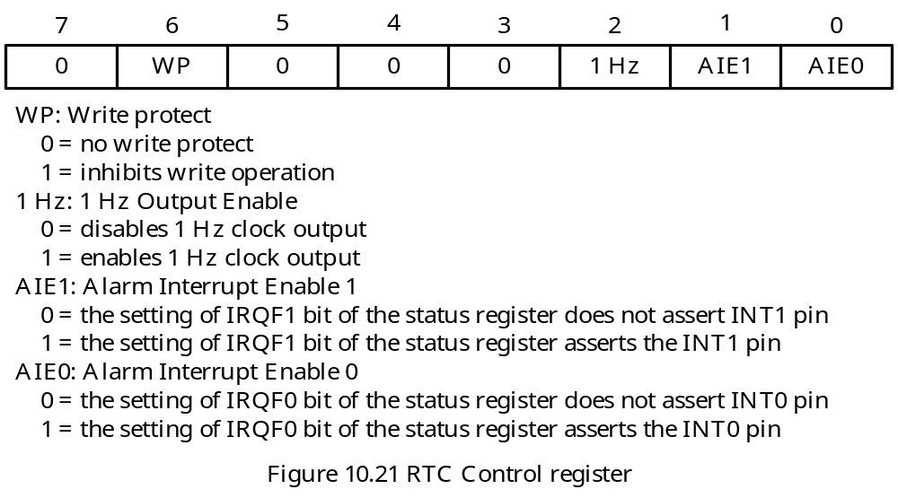
Control Register
provides write protection to registers.
enables/disables 1Hz output
enables/disables alarm 0 and alarm 1

Slide 75
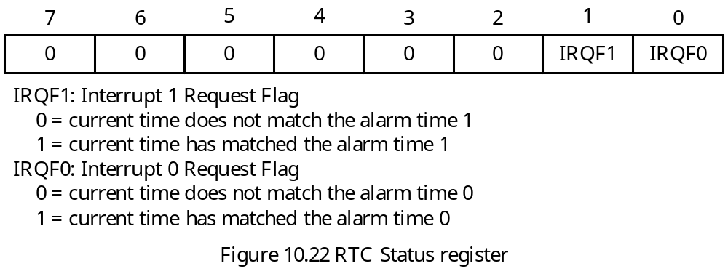
Status Register
- Records the status of the alarm time comparisons.
Trickle Charge Register
Controls the characteristic of the trickle charger
The trickle charger is shown in 10.23.
The contents of this register are shown in Figure 10.23.

Slide 76
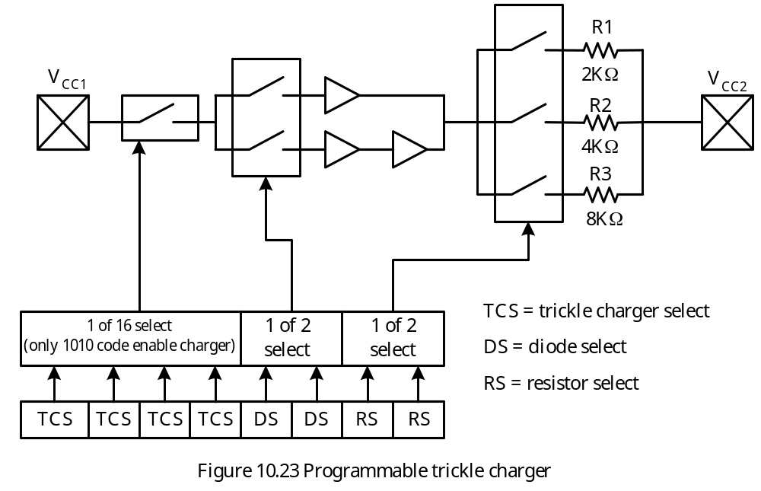

Slide 77
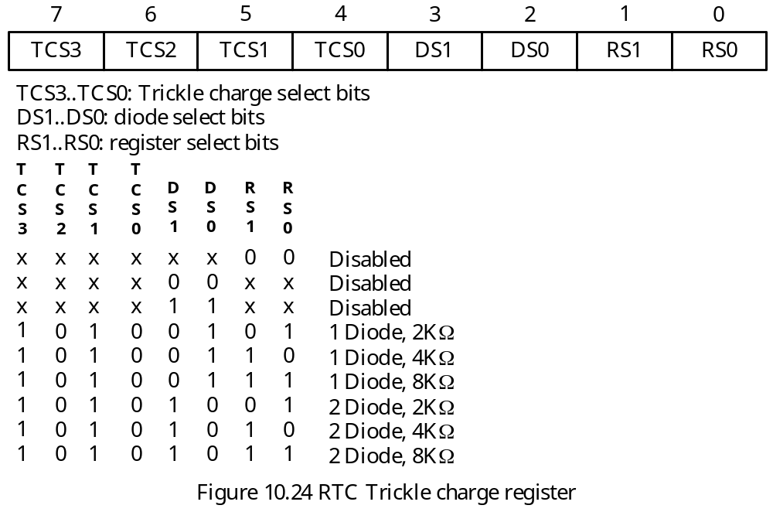

Slide 78
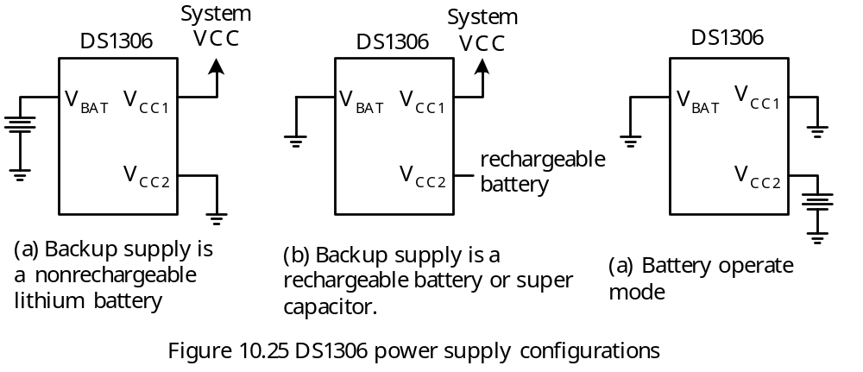
Serial Interface of DS1306
In SPI mode, SDO and SDI are separate pins and data are shifted in and out most significant bit first.
In 3-wire mode, SDO and SDI pin must be tied together and data are shifted in and out least significant bit first.
DS1306 can shift data in either edge of the SCLK signal.
Power Supply Configuration

Slide 79
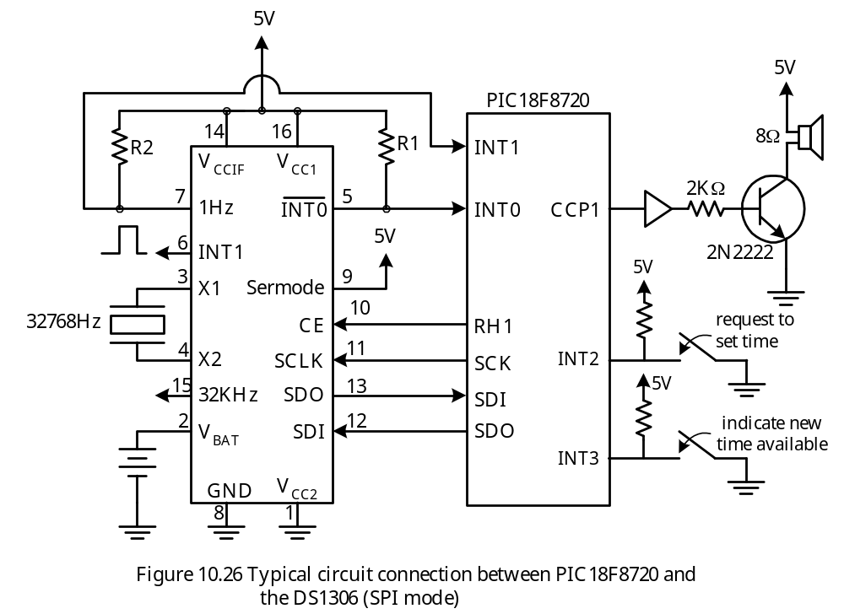
DS1306 Circuit Connection

Slide 80
In Figure 10.26, the DS1306 can be programmed to remind the PIC18 (via INT0 interrupt) to turn on the alarm when the alarm time is reached.
The user can use DIP switches to enter the time of day and alarm times to the PIC18 and transfer to the DS1306.
The 1Hz output reminds the PIC18 to update the current time display in a timely fashion.
Components of a System that Employs DS1306
1. Start up routine
2. Time update and display
3. Alarm generation

Slide 81
Example 10.6 For the SSE8720 demo board, write a start up routine to configure the DS1306 to operate with the following features:
- Enable alarm 0 interrupt and 1Hz output
Select 2KΩ and one diode for trickle charger
Solution:
1. The value to be written into the control register to enable alarm 0 interrupt and 1Hz output is 0x05.
2. The value to be written into the trickle charge register to select 2KΩ and one diode is 0xA5.
The following function will achieve the desired setting:

Slide 82
void Open_DS1306 (void)
{
unsigned char temp;
/* configure control register of the DS1306 */
PORTH |= 0x02; /* enable SPI transfer to DS1306 */
SSPBUF = 0x8F; /* send out the address of the control register */
while(!SSPSTATbits.BF);
temp = SSPBUF; /* clear the BF flag */
SSPBUF = 0x05; /* enable alarm 0 interrupt & 1Hz output */
while (!SSPSTATbits.BF);
temp = SSPBUF; /* clear the BF flag */
PORTH &= 0xFD; /* disable SPI transfer to DS1306 */
/* configure trickle charge register of the DS1306 */
PORTH |= 0x02; /* enable SPI transfer to DS1306 */
SSPBUF = 0x91; /* send out the address of trickle register */
while(!SSPSTATbits.BF);
temp = SSPBUF; /* clear the BF flag */
SSPBUF = 0xA5; /* select 2K & 1 diode for trickle charger */
while (!SSPSTATbits.BF);
temp = SSPBUF; /* clear the BF flag */
PORTH &= 0xFD; /* disable SPI transfer to DS1306 */
}

Slide 83
Example 10.7 Write a function to read time-of-day from the DS1306 and save it in the array cur_time[0..6].
Solution: The following C function will read the time-of-day from the DS1306:
char cur_time[11]; /* array to hold time-of-day and alarm time */
void read_time_of_day(void)
{
char i, temp2;
PORTHbits.RH1 = 1; /* enable SPI transfer to/from DS1306 */
SSPBUF = 0x00; /* send read address of second to DS1306 */
while (!SSPSTATbits.BF); /* wait until address is shifted out */
temp2 = SSPBUF; /* clear the BF flag */
for (i = 0; i < 7; i++) {
SSPBUF = 0x00; /* trigger 8 clock pulses */
while(!SSPSTATbits.BF);
cur_time[i] = SSPBUF; /* read time component i and clear BF */
}
PORTHbits.RH1 = 0; /* disable SPI transfer to/from DS1306 */
}

Slide 84
Example 10.8 Write a C function to send time-of-day stored in the array cur_time[0..6] to the DS1306.
Solution: The following C function will perform accordingly:
void send_cur_time(void)
{
char i, temp1;
PORTHbits.RH1 = 1; /* enable SPI transfer to DS1306 */
SSPBUF = 0x80; /* send out the write address of seconds */
while(!SSPSTATbits.BF);
temp1 = SSPBUF; /* clear the BF flag */
for (i = 0; i < 7; i++) {
SSPBUF = cur_time[i];
while(!SSPSTATbits.BF);
temp1 = SSPBUF; /* clear the BF flag */
}
PORTHbits.RH1 = 0; /* disable SPI transfer to DS1306 */
}

Slide 85
The current time-of-day must be formatted before it can be displayed.
The following example formats the time-of-day into two strings so that it can be displayed.
Example 10.9 Write a C function to convert the current time-of-day stored in the array cur_time[0..6] to two strings to be saved in two character arrays:
1. hms[0..11]. This array holds the hours, minutes, and seconds
2. dmy[0..11]. This array holds month, date, and year. The format of display is as
follows:
In 24-hour mode
hh:mm:ss:xx /* xx can be “SU”, “MO”, …, “SA” */
mm:dd:yy
In 12-hour mode
hh:mm:ss:ZM /* Z can be A or P */
xx:mm:dd:yy

Slide 86
void format_time(void)
{
char temp3;
temp3 = cur_time[3] & 0x07;
if (cur_time[2] & 0x40) { /* if 12-hour mode is used */
hms[0] = 0x30 + (cur_time[2] & 0x10) >> 4; /* ten's hour digit */
hms[1] = 0x30 + (cur_time[2] & 0x0F); /* one's hour digit */
hms[2] = ':';
hms[3] = 0x30 + (cur_time[1] & 0x70) >> 4; /* ten's minute digit */
hms[4] = 0x30 + (cur_time[1] & 0x0F); /* minute's digit */
hms[5] = ':';
hms[6] = 0x30 + (cur_time[0] & 0x70) >> 4; /* ten's second digit */
hms[7] = 0x30 + (cur_time[0] & 0x0F); /* second's digit */
hms[8] = ':';
if (cur_time[2]& 0x20)
hms[9] = 'P';
else
hms[9] = 'A';
hms[10] = 'M';
hms[11] = '\0'; /* terminate the string with a NULL */

Slide 87
switch (temp3) { /* convert to day of week */
case 1: dmy[0] = 'S';
dmy[1] = 'U';
break;
case 2: dmy[0] = 'M';
dmy[1] = 'O';
break;
case 3: dmy[0] = 'T';
dmy[1] = 'U';
break;
case 4: dmy[0] = 'W';
dmy[1] = 'E';
break;
case 5: dmy[0] = 'T';
dmy[1] = 'H';
break;
case 6: dmy[0] = 'F';
dmy[1] = 'R';
break;
case 7: dmy[0] = 'S';
dmy[1] = 'A';
break;

Slide 88
default: dmy[0] = 0x20; /* space */
dmy[1] = 0x20;
}
dmy[2] = ':';
dmy[3] = 0x30 + (cur_time[5] & 0x30) >> 4; /* month */
dmy[4] = 0x30 + (cur_time[5] & 0x0F); /* " */
dmy[5] = ':';
dmy[6] = 0x30 + (cur_time[4] & 0x30) >> 4; /* date */
dmy[7] = 0x30 + (cur_time[4] & 0x0F); /* " */
dmy[8] = ':';
dmy[9] = 0x30 + cur_time[6] >> 4; /* year */
dmy[10] = 0x30 + cur_time[6] & 0x0F; /* " */
dmy[11] = '\0'; /* NULL character */
} else { /* 24-hour mode */
hms[0] = 0x30 + (cur_time[2]& 0x30) >> 4; /* hours */
hms[1] = 0x30 + (cur_time[2]& 0x0F); /* " */
hms[2] = ':';
hms[3] = 0x30 + (cur_time[1]& 0x70) >> 4; /* minutes */
hms[4] = 0x30 + (cur_time[1]& 0x0F); /* " */
hms[5] = ':';
hms[6] = 0x30 + (cur_time[0]& 0x70) >> 4; /* seconds */
hms[7] = 0x30 + (cur_time[0]& 0x0F); /* " */

Slide 89
hms[8] = ':';
switch (temp3) {
case 1: hms[9] = 'S';
hms[10] = 'U';
break;
case 2: hms[9] = 'M';
dmy[10] = 'O';
break;
case 3: hms[9] = 'T';
hms[10] = 'U';
break;
case 4: hms[9] = 'W';
hms[10] = 'E';
break;
case 5: hms[9] = 'T';
hms[10] = 'H';
break;
case 6: hms[9] = 'F';
hms[10] = 'R';
break;
case 7: hms[9] = 'S';
hms[10] = 'A';

Slide 90
break;
default: hms[9] = 0x20; /* space */
hms[10] = 0x20;
}
hms[11] = '\0';
dmy[0] = 0x30 + (cur_time[5] & 0x30)>> 4 ; /* month */
dmy[1] = 0x30 + (cur_time[5] & 0x0F); /* month */
dmy[2] = ':';
dmy[3] = 0x30 + (cur_time[4] & 0x30) >> 4; /* date */
dmy[4] = 0x30 + (cur_time[4] & 0x0F); /* date */
dmy[5] = ':';
dmy[6] = 0x30 + cur_time[6] >> 4; /* year */
dmy[7] = 0x30 + cur_time[6] & 0x0F; /* year */
dmy[8] = '\0'; /* NULL character */
}
}

Slide 91
The following C function will display the previous two strings on the LCD:
void disp_time(void)
{
LCD_cmd(0x83); /* set cursor to the 3rd column of first row */
LCD_putsram(&hms[0]); /* display hours, minutes, and seconds */
LCD_cmd(0xC3); /* set cursor to the 3rd column of 2nd row */
LCD_putsram(&dmy[0]); /* display month, date, and year */
}

Slide 92
Example 10.10 Write the main program that controls the overall operation. The main program will
1. Initialize the SPI
2. Configure LCD
3. Set up the DS1306 operation
4. Stay in a while loop to wait for the flag set_time to be set true.
- When the set_time flag is true, the main program calls the get_cur_time( ) function to allow the user to enter the new time-of-day and the alarm time using the DIP switches
- Calls the send_cur_time( ) function to send the new time-of-day to the DS1306.
Solution:

Slide 93
void main (void)
{
OpenSPI(SPI_FOSC_16, MODE_00, SMPMID); /* configure SPI */
LCD_init(); /* configure LCD settings */
TRISH = 0x00; /* configure port H for output */
TRISF = 0xFF; /* configure port F for input */
ADCON1 = 0x0A; /* configure RF7 through RF0 for digital input */
TRISB = 0x0F; /* configure INT3..INT0 for input */
Open_DS1306( ); /* configure DS1306 */
/* initialize set_time to 0 */
set_time = 0;
/* enable priority interrupts */
INTCON2 = 0xBE; /* disable PORTB pullup, select active edges for INT0..INT3*/
INTCON3 = 0x48; /* set INT1 in high priority, enable INT1 interrupt */
RCON |= 0x80; /* enable priority interrupt */
INTCON = 0xD0; /* enable global and INT0 interrupts */
/* infinite loop to wait for set time request */

Slide 94
while (1) {
if (set_time){
INTCON3bits.INT3IE = 1; /* enable INT3 interrupt */
get_cur_time( ); /* get new time-of-day from keypad */
send_cur_time( ); /* send new time-of-day to DS1306 */
get_alarm_time( ); /* get new alarm time from keypad */
send_alarm_time( ); /* send new alarm time to DS1306 */
set_time = 0; /* done with set time */
INTCON3bits.INT3IE = 0; /* disable INT3 interrupt */
INTCONbits.INT0IE = 1; /* re-enable alarm interrupt */
INTCON3bits.INT1IE = 1; /* re-enable 1Hz interrupt */
}
}
}

Slide 95
Example 10. 11 Write the function get_cur_time.
Solution:
1. The current time is entered from year toward seconds.
2. The function outputs a prompt to ask the user to enter a time component.
3. Whenever a time component is set up in DIP, the user uses an INT3 interrupt to inform the PIC18 to read it.
void get_cur_time (void)
{
LCD_cmd(0x80); /* set cursor to row 1 column 1 */
LCD_putstr(msg1); /* remind user to enter year */
get_it = 0;
while(!get_it); /* wait for the user to set up new year in DIP switches */
cur_time[6] = time_buf; /* save year */
LCD_cmd(0x80); /* set cursor to row 1 column 1 */
LCD_putstr(msg2); /* remind user to enter month */
get_it = 0;
while (!get_it);
cur_time[5] = time_buf; /* save month */
LCD_cmd(0x80);
LCD_putstr(msg3); /* remind user to enter date of month */
get_it = 0;
while(!get_it);

Slide 96
cur_time[4] = time_buf; /* save date */
LCD_cmd(0x80); /* set cursor to row 1 column 1 */
LCD_putstr(msg4); /* remind user to enter day of week */
get_it = 0;
while(!get_it);
cur_time[3] = time_buf; /* save day-of-week */
LCD_cmd(0x80); /* set cursor to row 1 column 1 */
LCD_putstr(msg5); /* remind user to enter hours */
get_it = 0;
while(!get_it);
cur_time[2] = time_buf; /* save hours */
LCD_cmd(0x80); /* set cursor to row 1 column 1 */
LCD_putstr(msg6); /* remind user to enter minutes */
get_it = 0;
while(!get_it);
cur_time[1] = time_buf; /* save minutes */
LCD_cmd(0x80); /* set cursor to row 1 column 1 */
LCD_putstr(msg7); /* remind user to enter seconds */
get_it = 0;
while(!get_it);
cur_time[0] = time_buf; /* save seconds */
}

Slide 97
The messages that are used to inform the user to enter appropriate time components are as follows:
rom char *msg1 = "enter year:";
rom char *msg2 = "enter month:";
rom char *msg3 = "enter date of month:";
rom char *msg4 = "enter day of week:";
rom char *msg5 = "enter hours:";
rom char *msg6 = "enter minutes:";
rom char *msg7 = "enter seconds:";
rom char *msg8 = "enter alarm day:";
rom char *msg9 = "enter alarm hours:";
rom char *msg10 = "enter alarm minutes:";
rom char *msg11 = "enter alarm seconds:";

Slide 98
Example 10.12 Write a C function to trigger an alarm (2 KHz square waveform) using the PWM1 channel assuming the crystal oscillator frequency for the PIC18 MCU is 16 MHz.
Solution:
Use Timer2 as the base timer for PWM1.
Set the prescaler to Timer2 to 16
Write 124 to period register
Write 250 into CCPR1 as the duty cycle (50%)
Use variable alarm_remain to allow the alarm to last for 1 minutes
The 1Hz interrupt will decrement alarm_remain by 1
Set the flag in_alarm flag to 1 when the alarm is turned on

Slide 99
void trigger_alarm (void)
{
char temp4;
OpenTimer2(TIMER_INT_OFF & T2_PS_1_16 & T2_POST_1_1);
OpenTimer3(TIMER_INT_OFF & T3_16BIT_RW & T3_SOURCE_INT & T3_PS_1_1 & T12_SOURCE_CCP);
OpenPWM1(124); /* generate a PWM output at 2KHz */
SetDCPWM1(250); /* set duty cycle to 50% */
alarm_remain = 60; /* let alarm to last for 1 minute */
/* read alarm day to clear the IRQF0 flag */
PORTHbits.RH1 = 1; /* enable SPI transfer */
SSPBUF = 0x0A; /* send alarm day read address */
while(!SSPSTATbits.BF);
temp4 = SSPBUF; /* clear the BF flag */
SSPBUF = 0x00; /* read alarm day to clear the DS1306 alarm0 flag*/
while(!SSPSTATbits.BF);
temp4 = SSPBUF;
PORTHbits.RH1 = 0; /* disable SPI transfer */
}

Slide 100
Example 10.13 Write the interrupt service routines for INT0, INT1, and INT3.
Solution:
#pragma code
#pragma interrupt high_ISR
void high_ISR(void) /* This ISR services only INT0..INT3 interrupts */
{
if (INTCON3bits.INT3IF) { /* caused by user pressed on RB3/INT3 pin */
time_buf = PORTF; /* read a time component */
get_it = 1; /* informs get_cur_time that a time component is entered */
INTCON3bits.INT3IF = 0;
_asm
retfie 0
_endasm
}
if (INTCON3bits.INT1IF) { /* caused by 1Hz interrupt */
INTCON3bits.INT1IF = 0;

Slide 101
if (!PORTBbits.RB2) { /* check to see if user requests to enter new times */
set_time = 1;
INTCONbits.INT0IE = 0; /* temporarily disable alarm interrupt */
INTCON3bits.INT1IE = 0; /* temporarily disable 1Hz interrupt */
_asm
retfie 0
_endasm
}
else { /* no user request to enter new time-of-day */
read_time_of_day( );
format_time( );
disp_time( );
}
if (in_alarm) {
alarm_remain--;
if (alarm_remain == 0){
ClosePWM1( ); /* stop alarm */
in_alarm = 0; /* clear alarm flag */
}
}
}

Slide 102
if(INTCONbits.INT0IF){ /* interrupt caused by alarm at INT0 pin */
trigger_alarm(); /* start PWM1 to drive the speaker */
in_alarm = 1; /* indicate alarm is on */
INTCONbits.INT0IF = 0; /* clear the INT0IF flag */
}
_asm /* ignore all other interrupt */
retfie 0
_endasm
}

